Slide 1
NUMPY
Numerical Python

Slide 2
LESSON OBJECTIVE
By the end of this lesson, you will be able to:
Discuss the basics of NumPy, including its fundamental objects
Demonstrate how to create and print a NumPy array
Demonstrate how to execute linear algebraic functions
Analyze and perform basic operations in NumPy
Explain NumPy and its importance
Build basic programs using NumPy

Slide 3
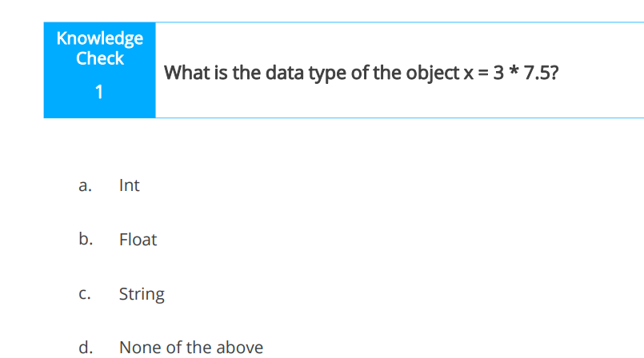
RECAP OF PREVIOUS LESSON

Slide 4
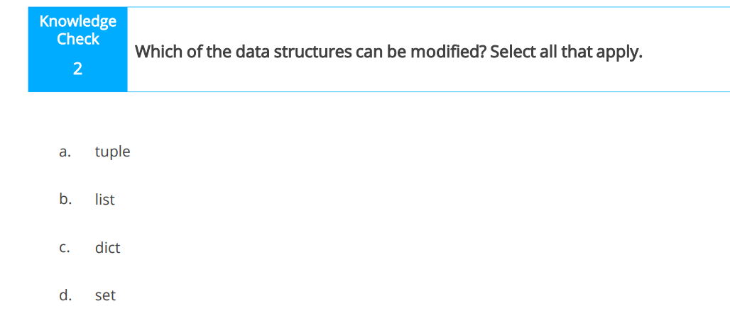

Slide 5
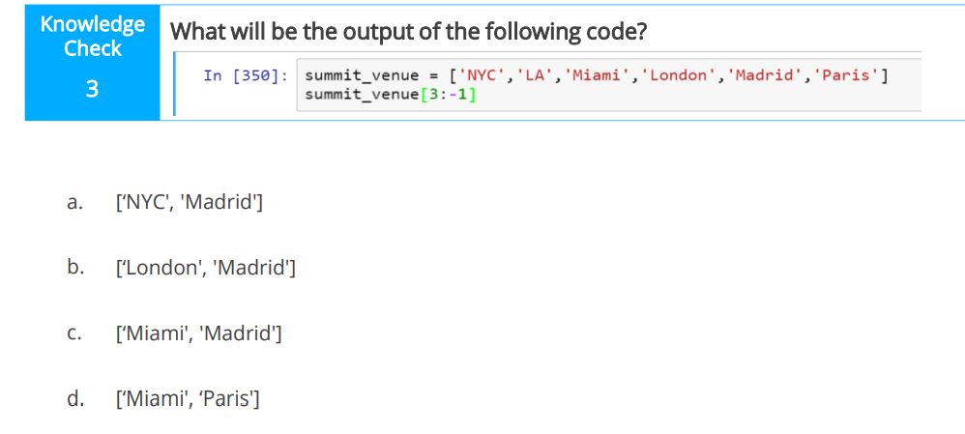

Slide 6
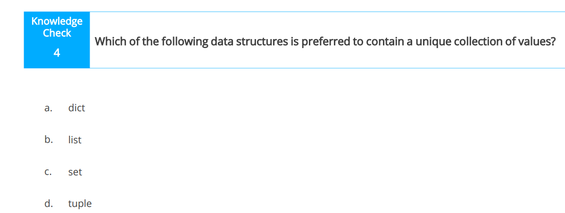

Slide 7
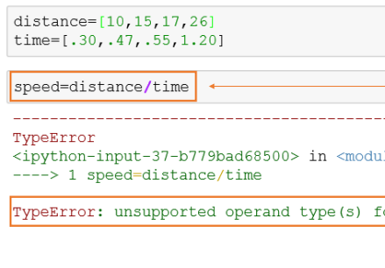
INTRODUCTION TO NUMPY
NumPy is the foundational package for mathematical computing in Python.
Just as we see in our last lesson that mathematical operations cannot be carried out in an entire list as seen below

Slide 8
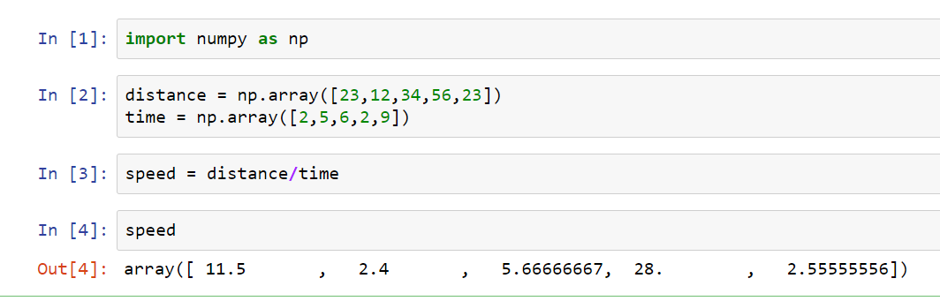
Numerical Python (NumPy) supports multidimensional arrays over which you can easily apply mathematical operations.

Slide 9
Attempt
Five government workers earn a salary of #90000, #120000, #150000, #180000 and #210000. If they all have a wardrobe allowance of #18000, #24000, #30000, #36000 and #42000 respectively. Express their total income in a list using your jupyter notebook.

Slide 10
Properties of Numpy
Supports fast and efficient multidimensional arrays (ndarray)
Performs linear algebraic operations, Fourier transforms, and random number generation
Efficient way of storing and manipulating data
Executes element-wise computations and mathematical calculations
Tools for reading/writing array based datasets to disk
Tools for integrating language codes (C, C++

Slide 11
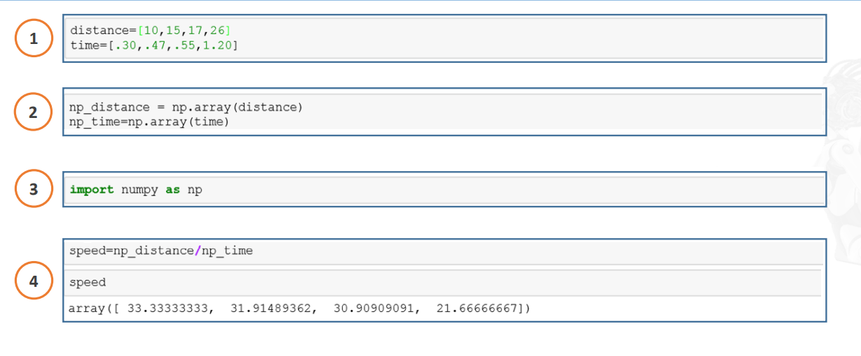
ATTEMPT THIS
The code here is buggy. You must correct its sequence to debug it.

Slide 12
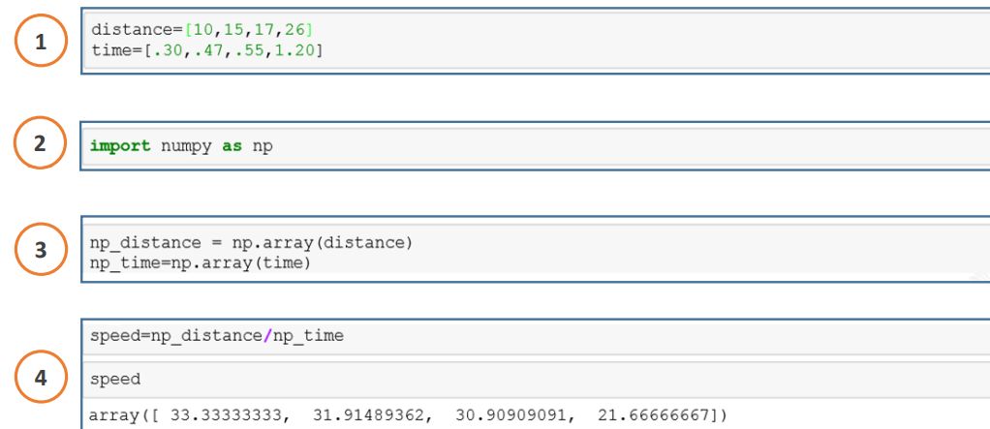

Slide 13
PROPERTIES OF NDARRAY
An array in NumPy has the following properties:
Collection of values
Add, remove, change
Single type (homogeneous)
Mathematical function support
Multidimensional
Fast and efficient

Slide 14


Types of Array
one-dimensional
two-dimensional

Slide 15
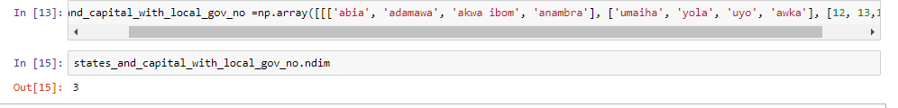
Three dimensional
Multidimensional

Slide 16
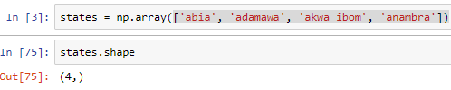
Classes and Attributes of ndarray:
Classes and Attributes of ndarray include :
.ndim: This refers to the number of axes (dimensions) of the array. It is also called the rank of the array. This has been well treated in the previous slide
.shape: This consists of a tuple of integers showing the size of the array in each dimension. The length of the shape tuple is the rank or ndim.

Slide 17
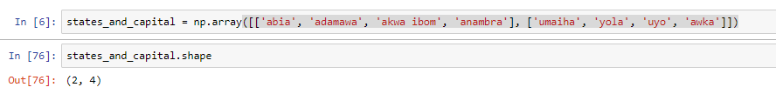
.size :It gives the total number of elements in the array. It is equal to the product of the elements of the shape tuple.

Slide 18
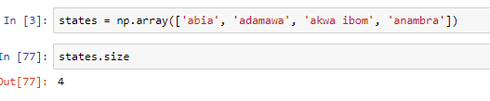
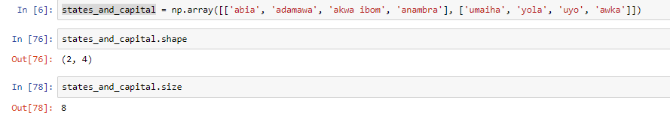

Slide 19
.dtype : It’s an object that describes the type of the elements in the array. It can be created or specified using Python

Slide 20
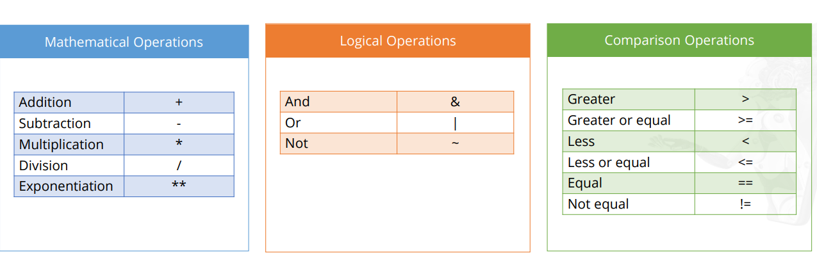
OPERATORS

Slide 21
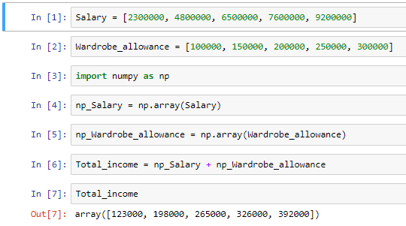
BASIC OPERATIONS : EXAMPLES

Slide 22
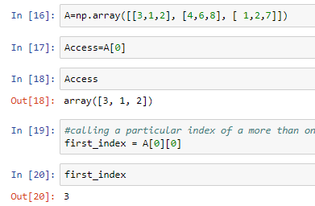
Accessing Array Elements: Indexing
You can access an entire row of an array by referencing its axis index.
You can refer the indices of the elements in an array to access them. You can also select a particular index of more than one axis at a time.

Slide 23
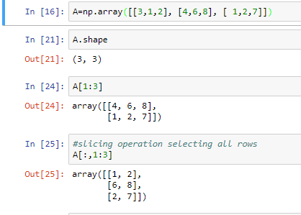
Slicing in arrays
Use the slicing method to access a range of values within an array.

Slide 24
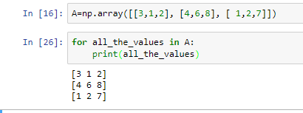
Accessing Array Elements: Iteration
We use the iteration method to go through each data element present in the dataset

Slide 25
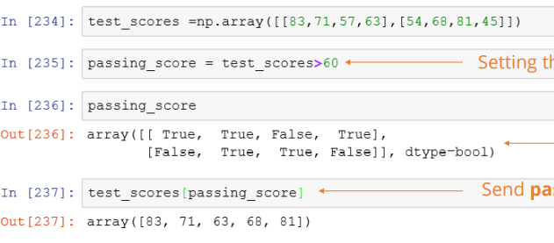
Indexing with Boolean Arrays
Boolean arrays are useful when you need to select a dataset according to set criteria.

Slide 26
Universal Functions (ufunc)
NumPy provides useful mathematical functions called Universal Functions. These functions operate element-wise on an array, producing another array as output. Some of these functions are:
sqrt function provides the square root of every element in the array.
floor function returns the largest integer value of every element in the array
cos function gives cosine values for all elements in the array.
exp function performs exponentiation on each element.

Slide 27
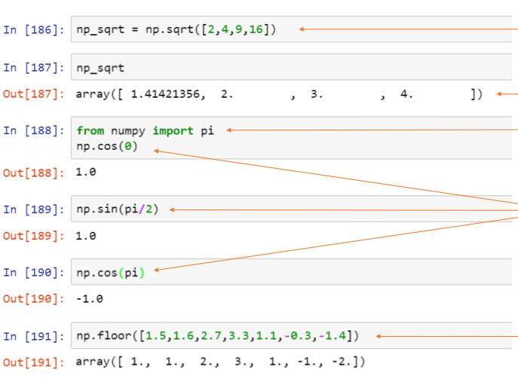

Slide 28
Shape Manipulation
You can use certain functions to manipulate the shape of an array.
The shape of an array can be changed according to the requirement using the NumPy library functions
Some common methods for manipulating shapes are:
Flatten
Resize
Stack
Reshape
Split

Slide 29
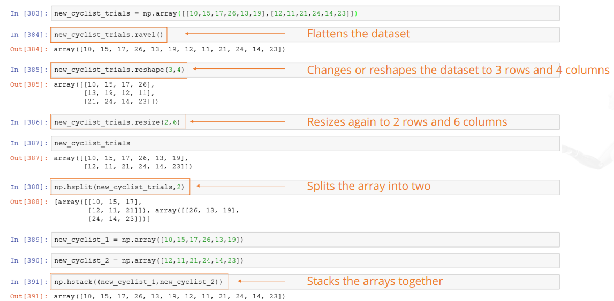

Slide 30
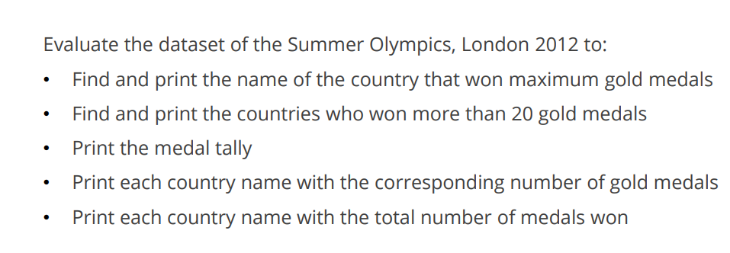

Slide 31
